Slide 1
Neural Machine Translation System Encoder-Decoder with Attention
Heshaam Faili
University of Tehran
Department of ECE
hfaili@ut.ac.ir
https://towardsdatascience.com/neural-machine-translation-15ecf6b0b

Slide 2
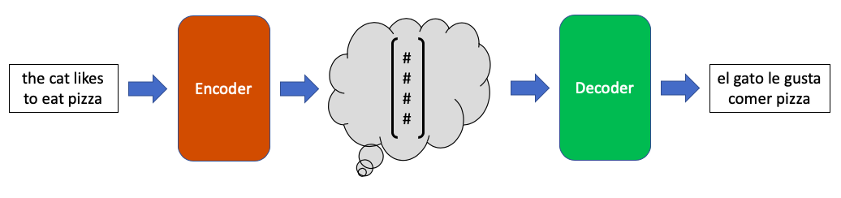
Encoder-Decoder

Slide 3
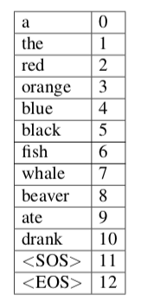
Vocabulary

Slide 4
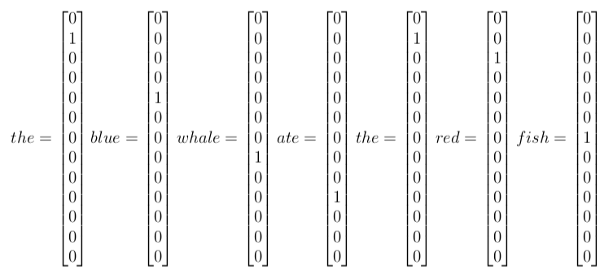
One hot vector

Slide 5
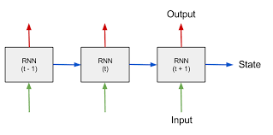
Recurrent Neural Network

Slide 6
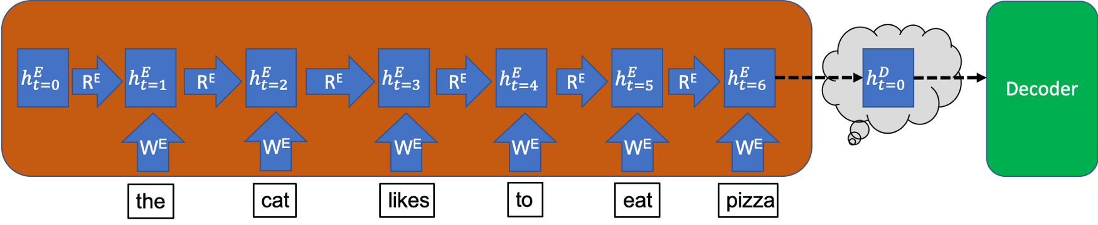
Encoder

Slide 7
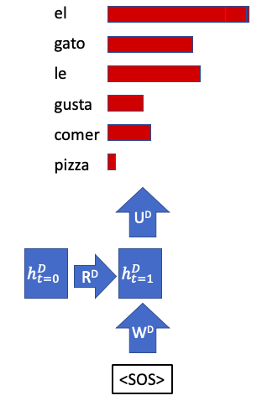
First step of Decoder

Slide 8
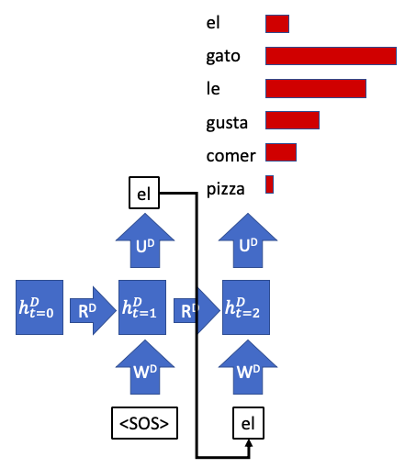
Second Step of Decoder

Slide 9
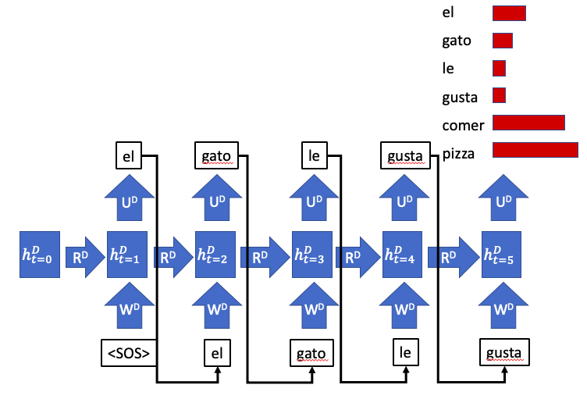
Translation Error

Slide 10
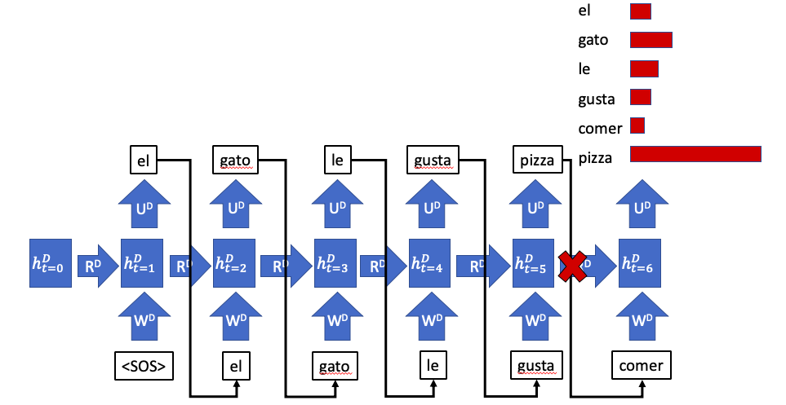
Teacher forcing

Slide 11
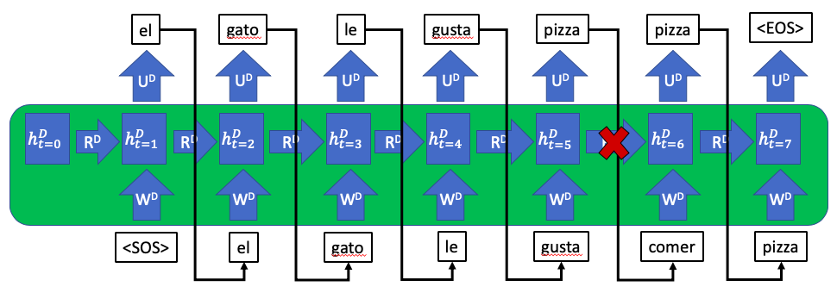
Decoder

Slide 12
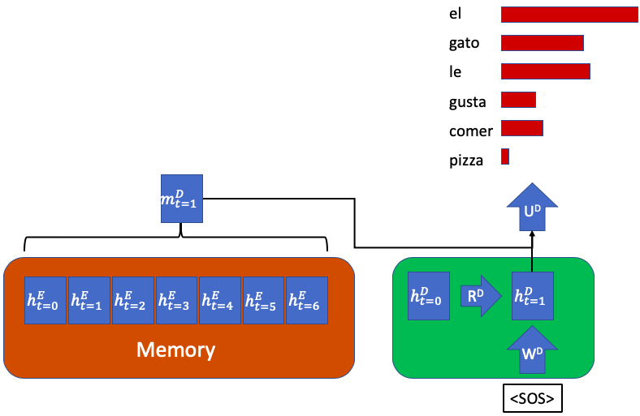
Attention-Based

Slide 13


